Slide 1
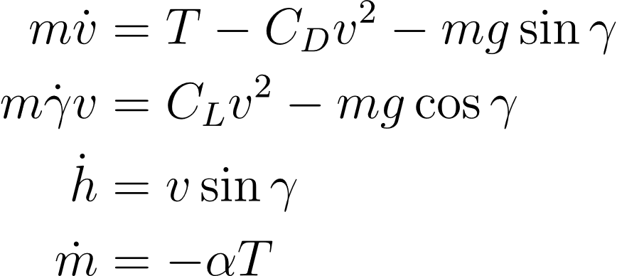
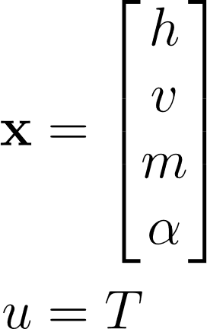
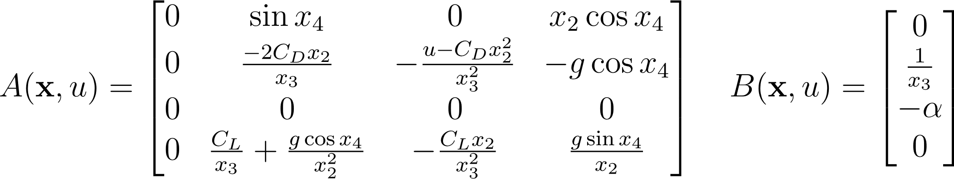
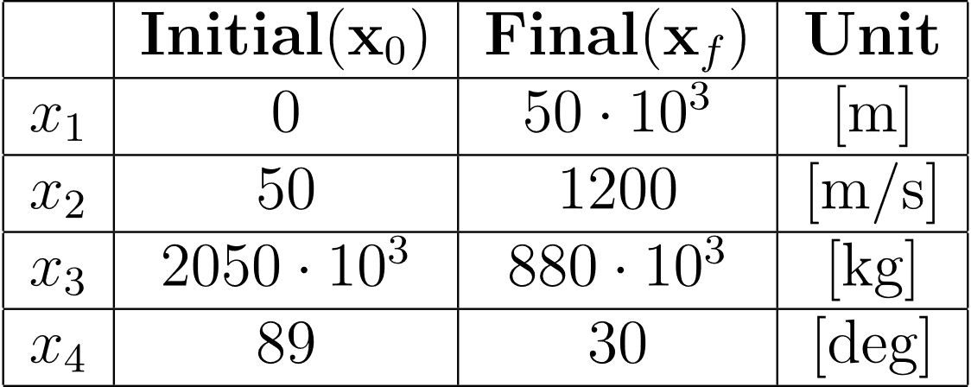
Nonlinear control problem (indirect approach)
Optimization of the shuttle’s thrust, based on gradient descent algorithm with free-end state, fixed final time.
NASA space shuttle has been taken as reference for parameters and trajectory data [1].
Cost function matrices chosen to prioritize final state accuracy while also limiting control effort. Upper bound on control given by maximum available thrust force ($u≤31,25{∙10}^{6}[N]$).
Q = diag([zeros(4, 1)]);
R = diag([1e-6]);
P = diag([300 1000 0.01 1]);
[1] Velocity-and-Acceleration-Profiles-of-Space-Shuttles_Kwan-Jie-Lee.pdf

Slide 2
